Slide 1

Introduction to Meteorological radar
ISCHMO 8 Feb. 2022 – Christchurch, NZ

Slide 2
Why Radars now?
Radar is the best instrument for monitoring the occurrence and movement of precipitation (and people do care about precipitation).
Radars provide the best information for precipitation timing, location, probability, intensity and type in the short term (0 – 6 hrs)
Best tool to detect or infer the presence of many hazardous weather conditions (severe thunderstorms, hail, tornadoes).
It can see within storms, and assess the severity
The information is available immediately and can be used at once.

Slide 3
What are radars?
Radars emit electromagnetic waves.
Electromagnetic waves are reflected if they meet an electrically leading surface.
If these reflected waves are received again at the place of their origin, then that means an obstacle is in the propagation direction.
The constant speed of light allows the determination of the distance between the reflecting objects (airplanes, ships, cars, building, birds, weather phenomenon) and the radar site by measuring the running time.
Notes:
The basic principle of operation of primary radar is simple to understand. However, the theory can be quite complex.

Slide 4
What are radars?
Notes:
1/ It generates a strong MW signal.
2/ It then focuses the signal in one direction to get information from targets that are located along that specific direction. This is the role of the antenna
3/ It receives a VERY faint echoes from the targets, the intensity of the returned signal being a tiny fraction of what was emitted.
4/ It then extracts as much raw data as possible from the received signal. E.G. target range, echo strength and velocity.

Slide 5
History of Radar
1900
Nicola Tesla: EM can be used for detecting moving metallic objects
1931
First known radar system from the UK. They equipped a ship with radar Work was abandoned for lack of government support
1939
World War II: J. Randall and A. Boot build a small radar that was fitted in B-17 airplanes. They could combat the German submarines in the night and in fog
1940
Radars were detecting large patches of echoes of unknown origin (Angel Echoes).
1943
Project Stormy Weather in Canada
1946
Development of the theory of scattering and attenuation of microwaves
1947
First weather radar conference (MIT).
First weather radar commissioned (USA)
1954-55
Several hurricanes struck the US Atlantic coast.
No radar to detect them.
1956
US Weather bureau gets funded to buy 31 radars (built by Raytheon).
1959
First operational weather radar (June in Miami)
14 others placed that year.
1962
The radar equation in meteorology!!!

Slide 6
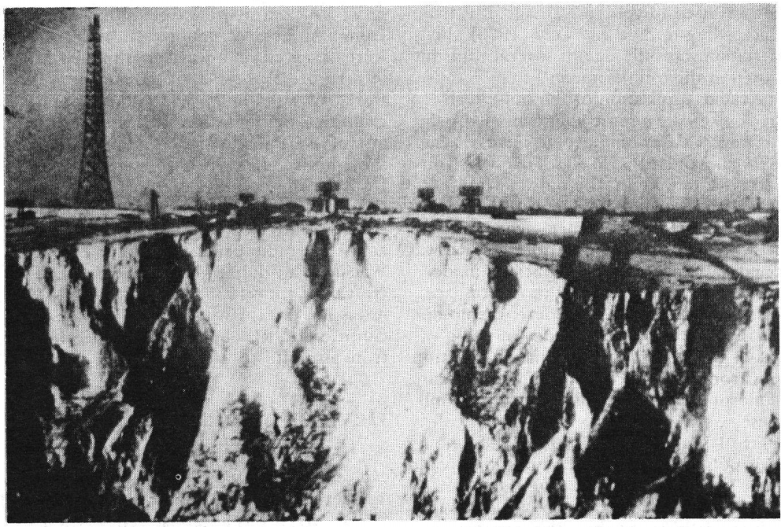
U.K. Radar Stations on Cliff at Dover, England. Tall CH tower on left. Four rectangular CHL antennas in centre. Photograph by German reconnaissance plane, 1940

Slide 7
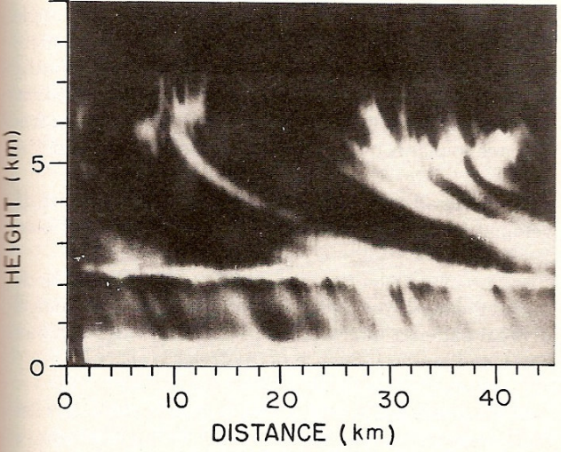
Angel Echoes.

Slide 8
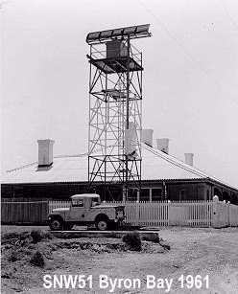
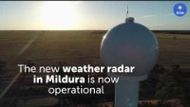
First Australian radar at Byron Bay on the north coast of NSW, operated by the Lighthouse Staff.
New Dual-Polarisation radar in Mildura, VIC.

Slide 9
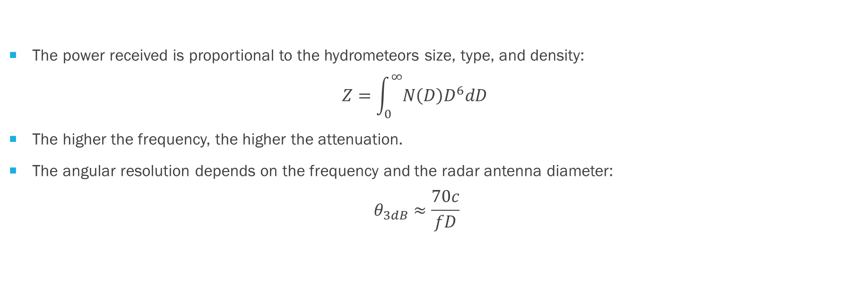
What you should know about radars:
The power received is proportional to the hydrometeors size, type, and density:
$$Z=\int_{0}^{∞}{N\left(D\right)D^{6}dD }$$
The higher the frequency, the higher the attenuation.
The angular resolution depends on the frequency and the radar antenna diameter:
$$θ_{3dB}≈\frac{70c}{fD}$$

Slide 10
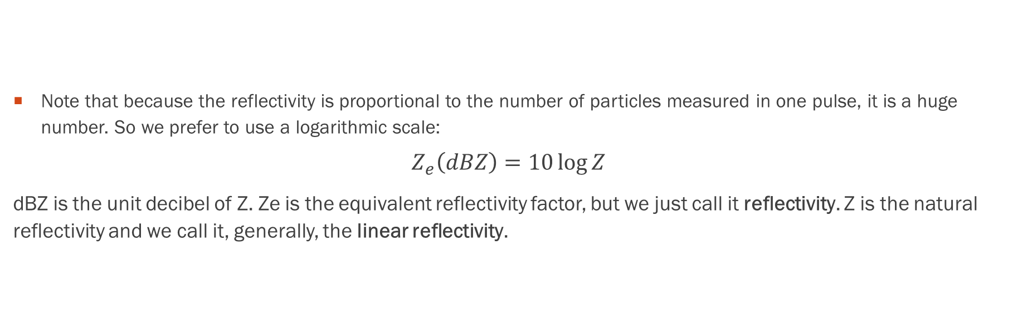
What you should know about radars:
Note that because the reflectivity is proportional to the number of particles measured in one pulse, it is a huge number. So we prefer to use a logarithmic scale:
$$Z_{e}\left(dBZ\right)=10\log{Z}$$
dBZ is the unit decibel of Z. Ze is the equivalent reflectivity factor, but we just call it reflectivity. Z is the natural reflectivity and we call it, generally, the linear reflectivity.

Slide 11
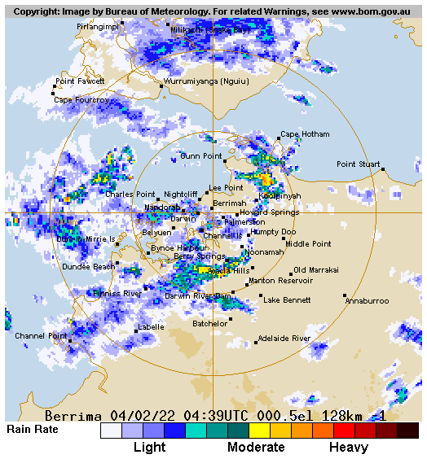
Reflectivity (dBZ) | Rainfall rate (mm/h) | Intensity
5 | 0.07 | Hardly noticeable
10 | 0.15 | Light mist
15 | 0.3 | Mist
20 | 0.6 | Very light
25 | 1.3 | Light
30 | 2.7 | Light to moderate
35 | 5.6 | Moderate rain
40 | 11.53 | Moderate rain
45 | 23.7 | Moderate to heavy
50 | 48.6 | Heavy
55 | 100 | Very heavy/small hail
60 | 205 | Extreme/moderate hail
65 | 421 | Extreme/large hail

Slide 12
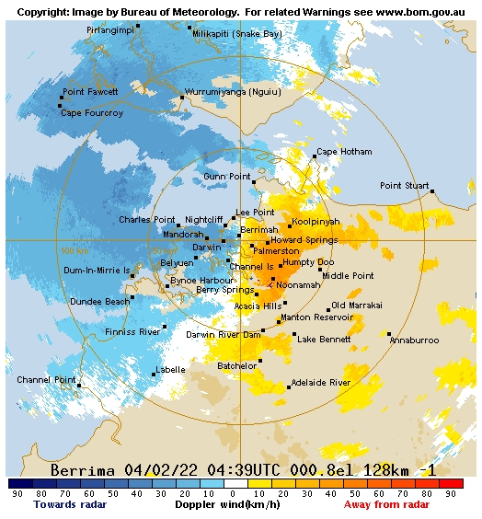
Doppler velocity

Slide 13
Radar frequency bands
Type | Band | f (GHZ) | Λ (cm) | Diam. (θ=1) | Comments
Precipitation | S | 2 – 4 | 7.5 – 15 (10.2) | 7 m | Not attenuated (400 km coverage)
 | C | 4 – 8 | 3.8 – 7.5 (5.5) | 3.9 m | Weak attenuation by strong precipitation only
 | X | 8 – 12 | 2.4 – 3.8 (3.2) | 2.2 m | Attenuated (75 km coverage)
_{Clouds} | K_{u} | 12 – 18 | 1.7 – 2.4 (2.0) | 1.4 m | Clouds (not precipitating) (30 - 50 km)
 | K_{a} | 27 – 40 | 0.8 – 1.1 (0.96) | 0.7 m | Clouds (not precipitating)
Cirrus | W | 75 – 110 | 0.3 – 0.4 (0.32) | 0.2 m | Very strongly attenuated outside of ice crystals (a few km)

Slide 14
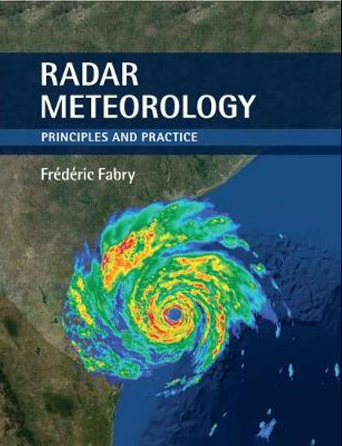
Bibliography
Fabry, F. (2015). Radar Meteorology: Principles and Practice. Cambridge: Cambridge University Press. doi:10.1017/CBO9781107707405
Doviak and Zrnic (2006) Doppler Radar & Weather Observations. Academic Press

